Slide 1
Introducing TDD with React

Slide 2

Pretest
What is Test-driven Development?
What is React?
How to get started with TDD and React

Slide 3
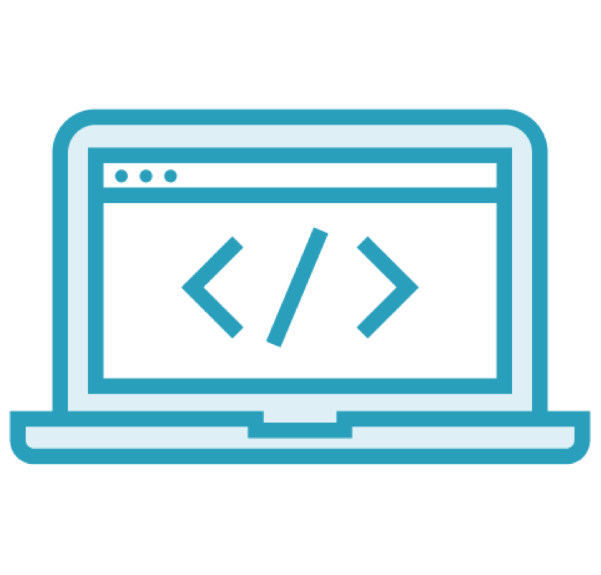

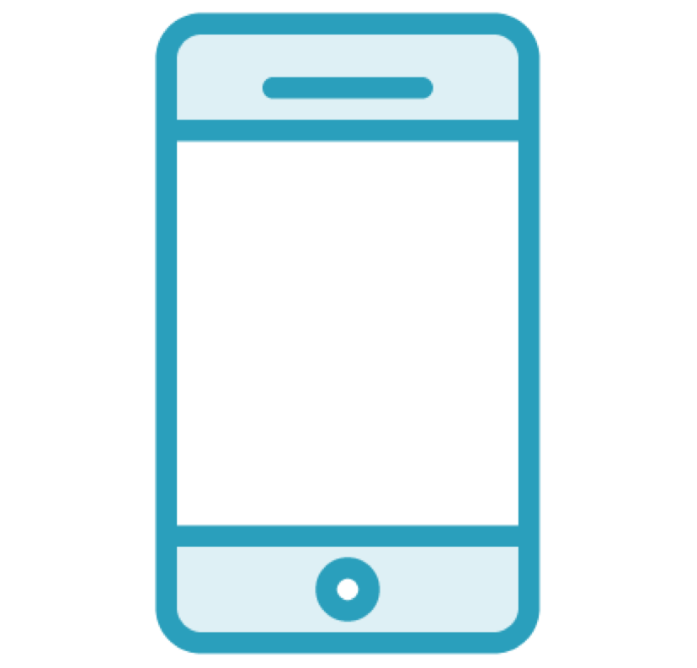
Front-end Development Is Complex
Languages
Tools
Devices

Slide 4
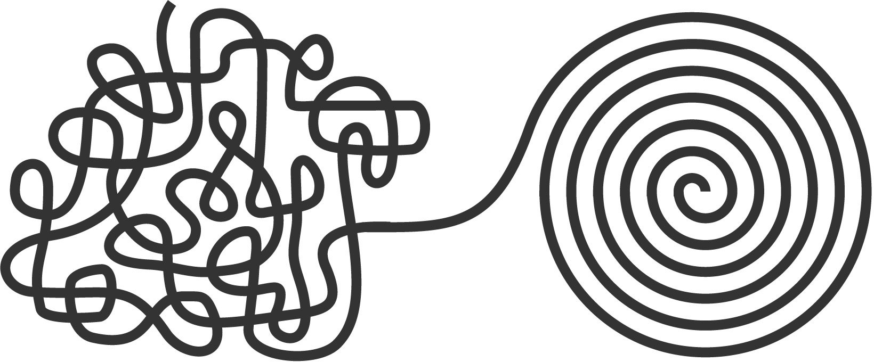
It Doesn't Need to Be Chaotic

Slide 5












Introducing Test-driven Development
TEST
REFACTOR
CODE

Slide 6
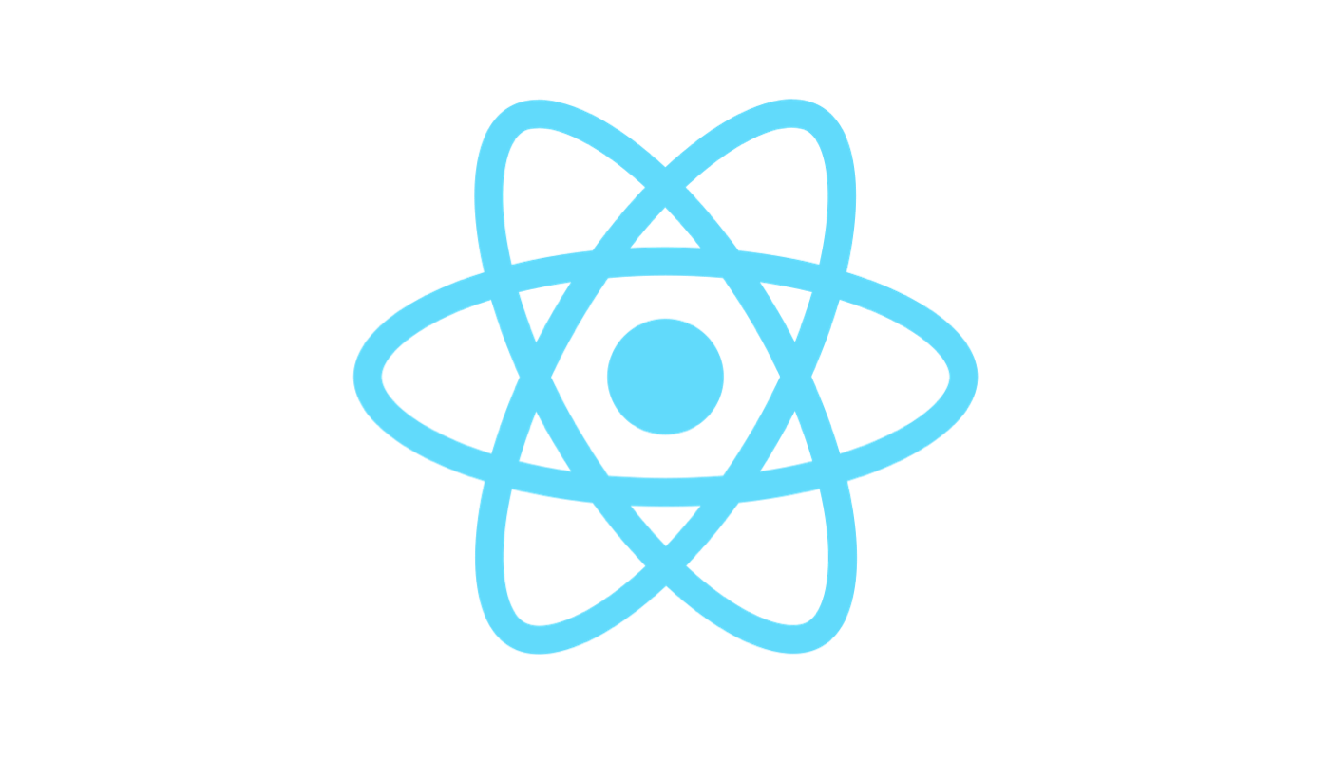
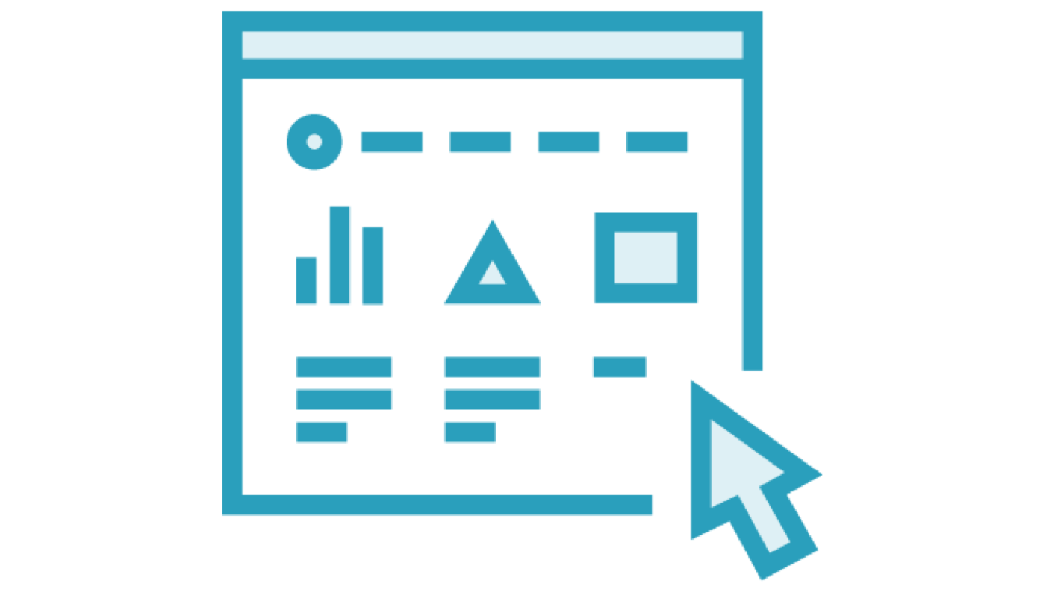
React
A JavaScript library
For building user interfaces

Slide 7







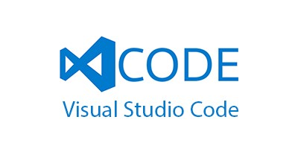
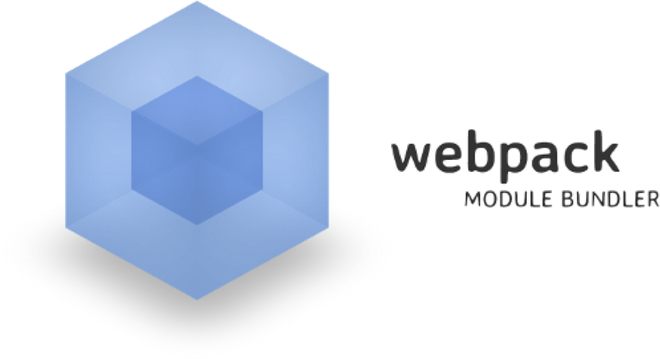







Welcome to Front-end Development

Slide 8

Demo
Introducing Create React App

Slide 9
Demo
Hello, component

Slide 10
Demo
Refactoring

Slide 11
Demo
Setting up your tools

Slide 12
Summary
Goal of TDD === Clean code that works
Goal of React === fast, scalable, simple

Slide 13
Discovering the Need for TDD
COMING UP NEXT

